Slide 1
Statistics 367-1-4361 Categorical Data
Opher Donchin

Slide 2
9A Multiple categories

Slide 3
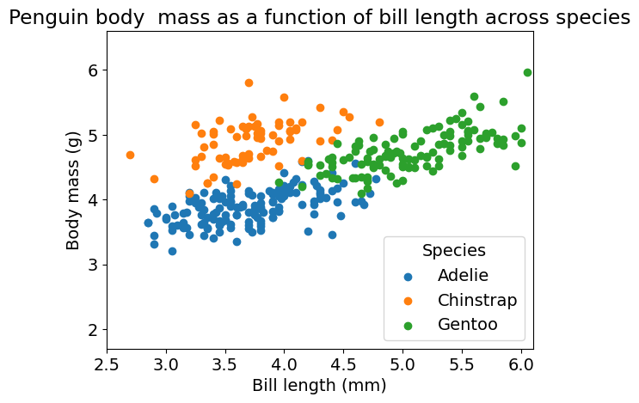
Penguins with large bills are heavier

Slide 4
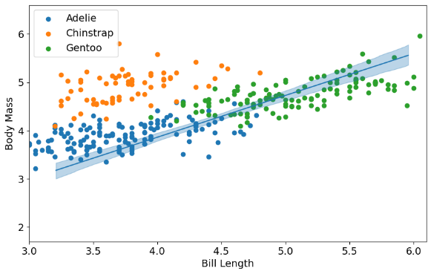
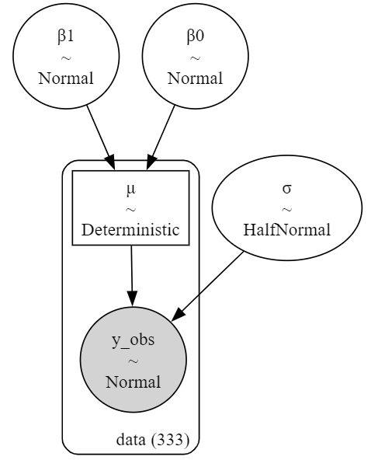
A model that does not consider species
with pm.Model(coords=coords) as penguins_pooled_pymc_model:
β0 = pm.Normal("β0", mu=0, sigma=10)
β1 = pm.Normal("β1", mu=0, sigma=10)
σ = pm.HalfNormal("σ", sigma=1)
μ = pm.Deterministic("μ", β0 + β1 * penguins.bill_length, dims="data")
y_obs = pm.Normal("y_obs", mu=μ, sigma=σ, observed=penguins.body_mass, dims="data")

Slide 5

How to make the plot
Vector with dimensions for the x axis
x_grid = xr.DataArray(
np.linspace(penguins.bill_length.min(), penguins.bill_length.max(), 100),
dims="plot_x"
)
posterior = idata_pooled_pm.posterior
μ_samples = (
posterior["β0"] + posterior["β1"] * x_grid
)
fig, ax = plt.subplots(figsize=(10, 6))
for cat in unique_categories:
category_data = penguins[penguins.species == cat]
plt.scatter(category_data.body_mass, category_data.bill_length, c=category_color_map[cat], label=cat)
mean_μ = μ_samples.mean(dim=("chain", "draw"))
ax.plot(x_grid, mean_μ, color="C0")
# Plot the HDI band
az.plot_hdi(x_grid, μ_samples, hdi_prob=0.94, color="C0", smooth=False, fill_kwargs={"alpha":0.3}, ax=ax)

Slide 6
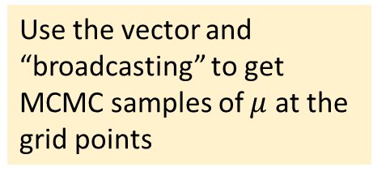
How to make the plot
Use the vector and “broadcasting” to get MCMC samples of $μ$ at the grid points
x_grid = xr.DataArray(
np.linspace(penguins.bill_length.min(), penguins.bill_length.max(), 100),
dims="plot_x"
)
posterior = idata_pooled_pm.posterior
μ_samples = (
posterior["β0"] + posterior["β1"] * x_grid
)
fig, ax = plt.subplots(figsize=(10, 6))
for cat in unique_categories:
category_data = penguins[penguins.species == cat]
plt.scatter(category_data.body_mass, category_data.bill_length, c=category_color_map[cat], label=cat)
mean_μ = μ_samples.mean(dim=("chain", "draw"))
ax.plot(x_grid, mean_μ, color="C0")
# Plot the HDI band
az.plot_hdi(x_grid, μ_samples, hdi_prob=0.94, color="C0", smooth=False, fill_kwargs={"alpha":0.3}, ax=ax)

Slide 7
How to make the plot
x_grid = xr.DataArray(
np.linspace(penguins.bill_length.min(), penguins.bill_length.max(), 100),
dims="plot_x"
)
posterior = idata_pooled_pm.posterior
μ_samples = (
posterior["β0"] + posterior["β1"] * x_grid
)
fig, ax = plt.subplots(figsize=(10, 6))
for cat in unique_categories:
category_data = penguins[penguins.species == cat]
plt.scatter(category_data.body_mass, category_data.bill_length, c=category_color_map[cat], label=cat)
mean_μ = μ_samples.mean(dim=("chain", "draw"))
ax.plot(x_grid, mean_μ, color="C0")
# Plot the HDI band
az.plot_hdi(x_grid, μ_samples, hdi_prob=0.94, color="C0", smooth=False, fill_kwargs={"alpha":0.3}, ax=ax)
Plot the underlying data

Slide 8
How to make the plot
x_grid = xr.DataArray(
np.linspace(penguins.bill_length.min(), penguins.bill_length.max(), 100),
dims="plot_x"
)
posterior = idata_pooled_pm.posterior
μ_samples = (
posterior["β0"] + posterior["β1"] * x_grid
)
fig, ax = plt.subplots(figsize=(10, 6))
for cat in unique_categories:
category_data = penguins[penguins.species == cat]
plt.scatter(category_data.body_mass, category_data.bill_length, c=category_color_map[cat], label=cat)
mean_μ = μ_samples.mean(dim=("chain", "draw"))
ax.plot(x_grid, mean_μ, color="C0")
# Plot the HDI band
az.plot_hdi(x_grid, μ_samples, hdi_prob=0.94, color="C0", smooth=False, fill_kwargs={"alpha":0.3}, ax=ax)
Plot the mean line

Slide 9

How to make the plot
x_grid = xr.DataArray(
np.linspace(penguins.bill_length.min(), penguins.bill_length.max(), 100),
dims="plot_x"
)
posterior = idata_pooled_pm.posterior
μ_samples = (
posterior["β0"] + posterior["β1"] * x_grid
)
fig, ax = plt.subplots(figsize=(10, 6))
for cat in unique_categories:
category_data = penguins[penguins.species == cat]
plt.scatter(category_data.body_mass, category_data.bill_length, c=category_color_map[cat], label=cat)
mean_μ = μ_samples.mean(dim=("chain", "draw"))
ax.plot(x_grid, mean_μ, color="C0")
# Plot the HDI band
az.plot_hdi(x_grid, μ_samples, hdi_prob=0.94, color="C0", smooth=False, fill_kwargs={"alpha":0.3}, ax=ax)
Plot the hdi

Slide 10
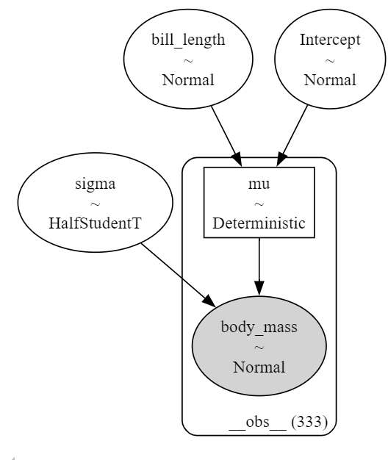
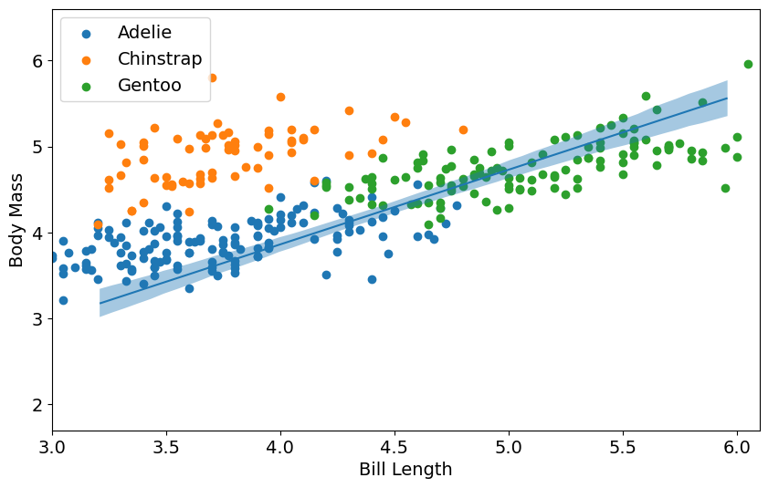
A Bambi model that does not consider species
model_pooled_bmb = bmb.Model("body_mass ~ bill_length", data=penguins)
model_pooled_bmb.graph()
bmb.interpret.plot_predictions(model_pooled_bmb, idata_pooled_bmb, ["bill_length"])

Slide 11
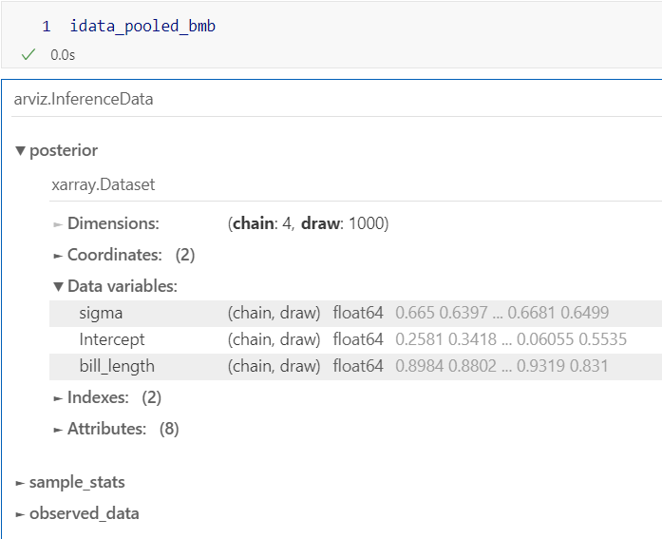

A model that does not consider species
model_pooled_bmb = bmb.Model("body_mass ~ bill_length", data=penguins)

Slide 12
9B Unpooled category model

Slide 13
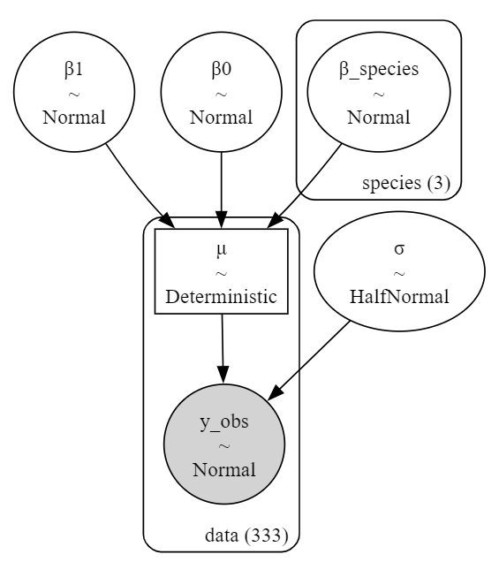
A model that does consider species
with pm.Model(coords=coords) as model_unpooled_pm:
β0 = pm.Normal("β0", mu=0, sigma=10)
β1 = pm.Normal("β1", mu=0, sigma=10)
β_species = pm.Normal("β_species", mu=0, sigma=10, dims="species")
σ = pm.HalfNormal("σ", sigma=1)
μ = pm.Deterministic(
"μ",
β0 + β1 * penguins.bill_length.values + β_species[species_codes],
dims="data"
)
y_obs = pm.Normal("y_obs", mu=μ, sigma=σ, observed=penguins.body_mass, dims="data")

Slide 14
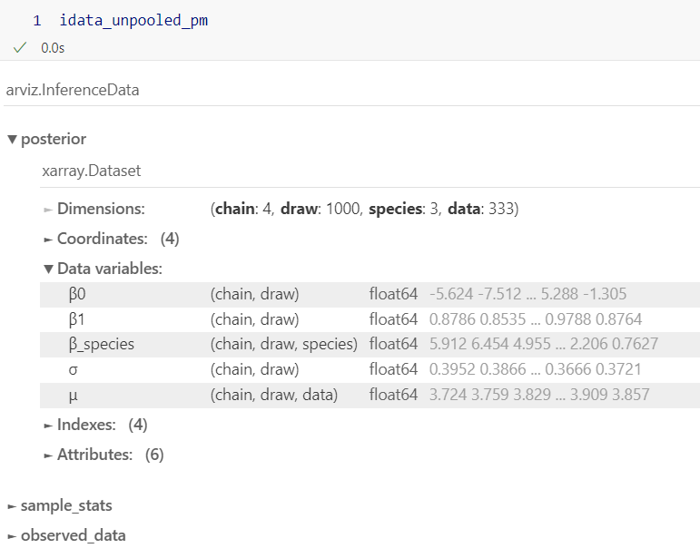
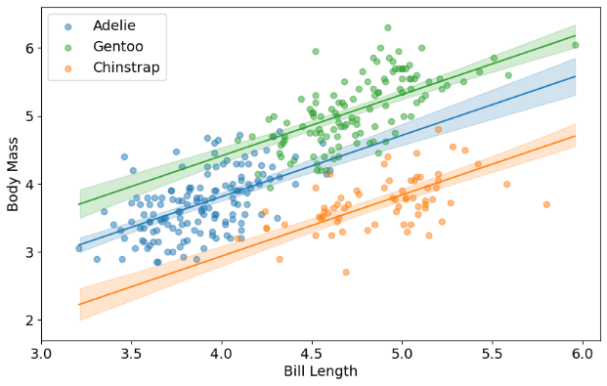
A model that does consider species

Slide 15
How to make the new plot
for cat in species_categories:
cat_index = np.where(species_categories == cat)[0][0]
μ_samples = (
posterior["β0"] +
posterior["β1"] * x_grid +
posterior["β_species"][:, :, cat_index]
)

Slide 16
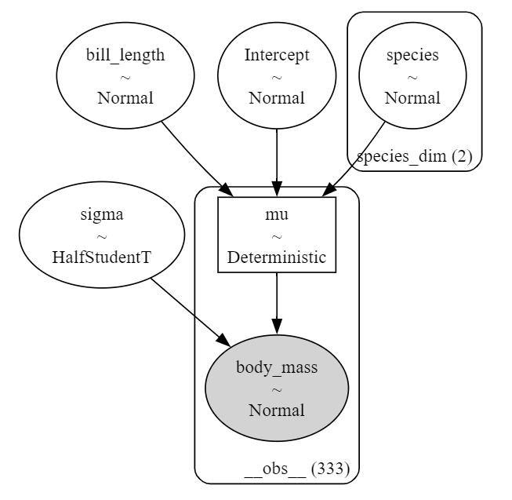
Bambi model with species
model_p = bmb.Model("body_mass ~ bill_length + species", data=penguins)
Similar structure
PyMC Model
Bambi Model

Slide 17
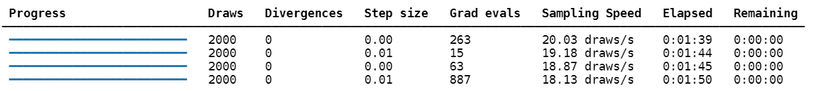
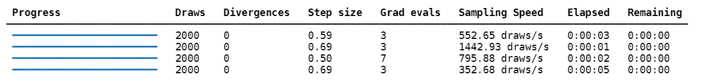
Bambi model with species
model_p = bmb.Model("body_mass ~ bill_length + species", data=penguins)
Much easier sampling
PyMC Model
Bambi Model

Slide 18
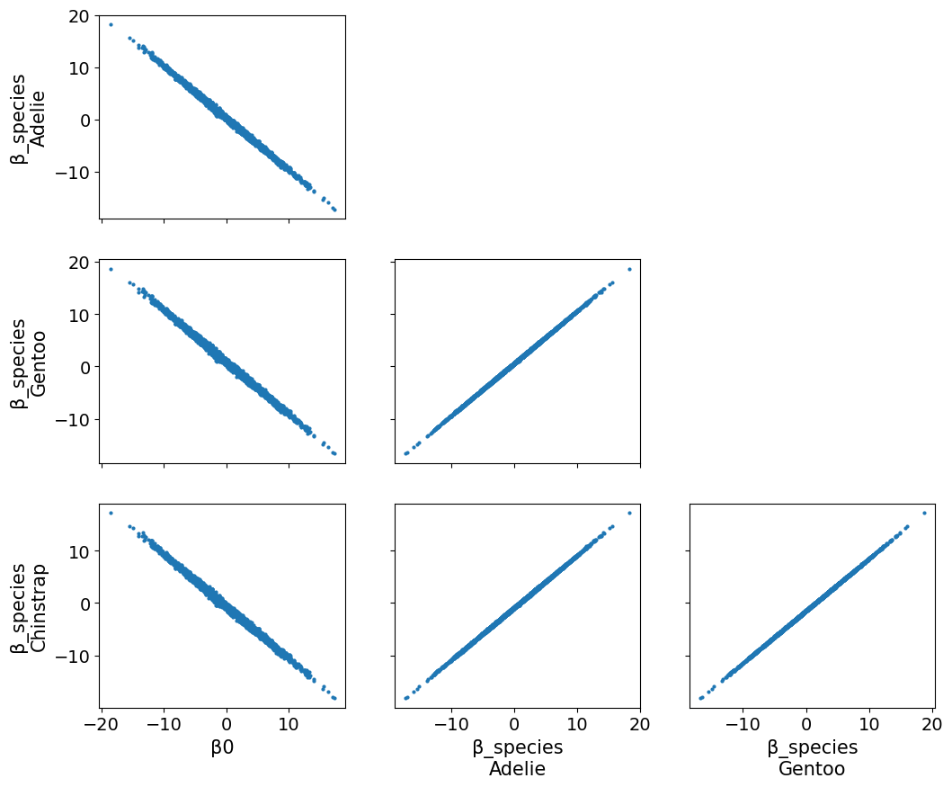
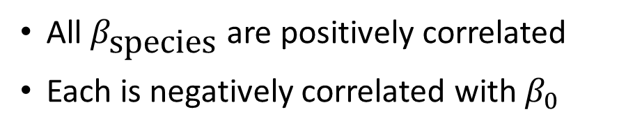
Variables are highly correlated in PyMC model
PyMC Model
All $β_{\text{species}}$ are positively correlated
Each is negatively correlated with $β_{0}$
az.plot_pair(
idata_unpooled_pm,
var_names=['β0', 'β_species'],
);

Slide 19
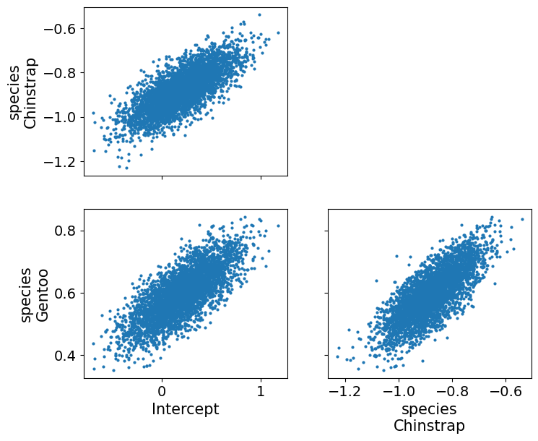
But not in the Bambi model
az.plot_pair(
idata_unpooled_bmb,
var_names=['Intercept', 'species’]
);
PyMC Model
The Bambi model
Has 2 species parameters instead of 3
Normalizes variables before modeling
Bambi Model

Slide 20
The PyMC model is over-specified
Increase the intercept and decrease all the species
And the model is unchanged
PyMC Model
Nothing is changed!

Slide 21
Bambi model parameters are differences
One group is the reference group
Parameters for other groups are the difference
PyMC Model
Nothing is changed!

Slide 22
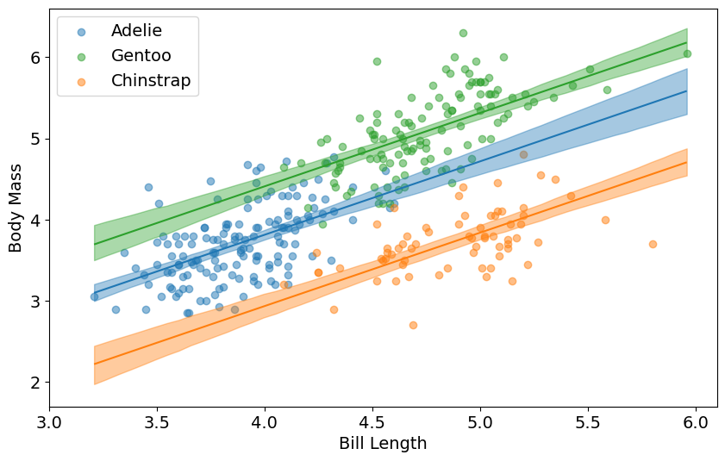
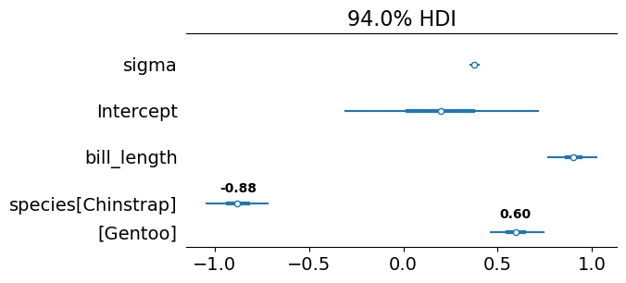
Plot predictions interprets the parameters
bmb.interpret.plot_predictions(model_p, idata_p, ["bill_length", "species"])
az.plot_forest(idata_unpooled_bmb, combined=True);
A fixed PyMC model based on reference coding is in the notebook

Slide 23
9C Hierarchical categorical model

Slide 24
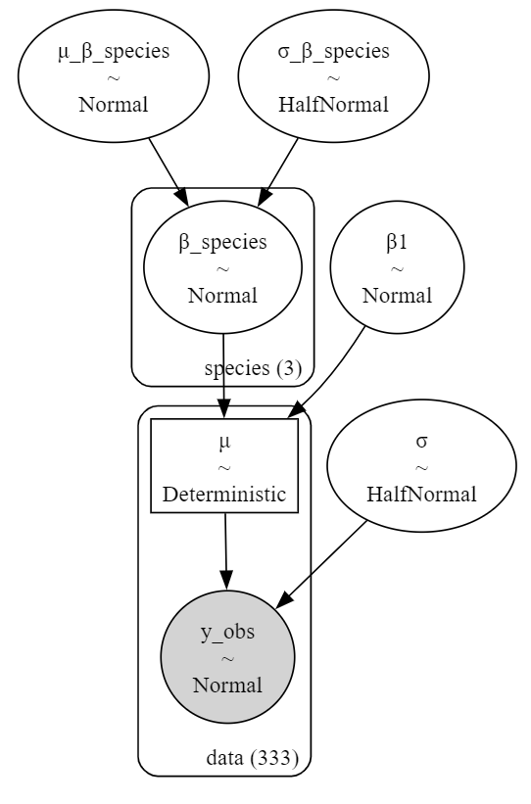
Add a hierarchical layer to the species
What we know about one species tells us about another
with pm.Model(coords=coords) as model_hierarchical_pm:
μ_β_species = pm.Normal('μ_β_species', mu=0, sigma=10)
σ_β_species = pm.HalfNormal('σ_β_species', sigma=5)
β1 = pm.Normal("β1", mu=0, sigma=10)
β_species = pm.Normal("β_species", mu=μ_β_species, sigma=σ_β_species, dims="species")
σ = pm.HalfNormal("σ", sigma=1)
μ = pm.Deterministic(
"μ",
β1 * penguins.bill_length.values + β_species[species_codes],
dims="data"
)
y_obs = pm.Normal("y_obs", mu=μ, sigma=σ, observed=penguins.body_mass, dims="data")

Slide 25
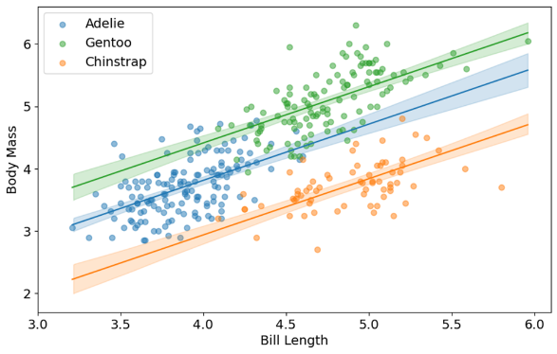

No big difference between the models
Unpooled model
Hierarchical model

Slide 26
When to add hierarchy
Fixed effect
We care about the specific species
We want to see the actual difference between groups
No hierarchy
Random effect
The species aren’t the focus of interest
They are a sort of noise
We want to estimate the variance of the difference between groups
Hierarchy

Slide 27
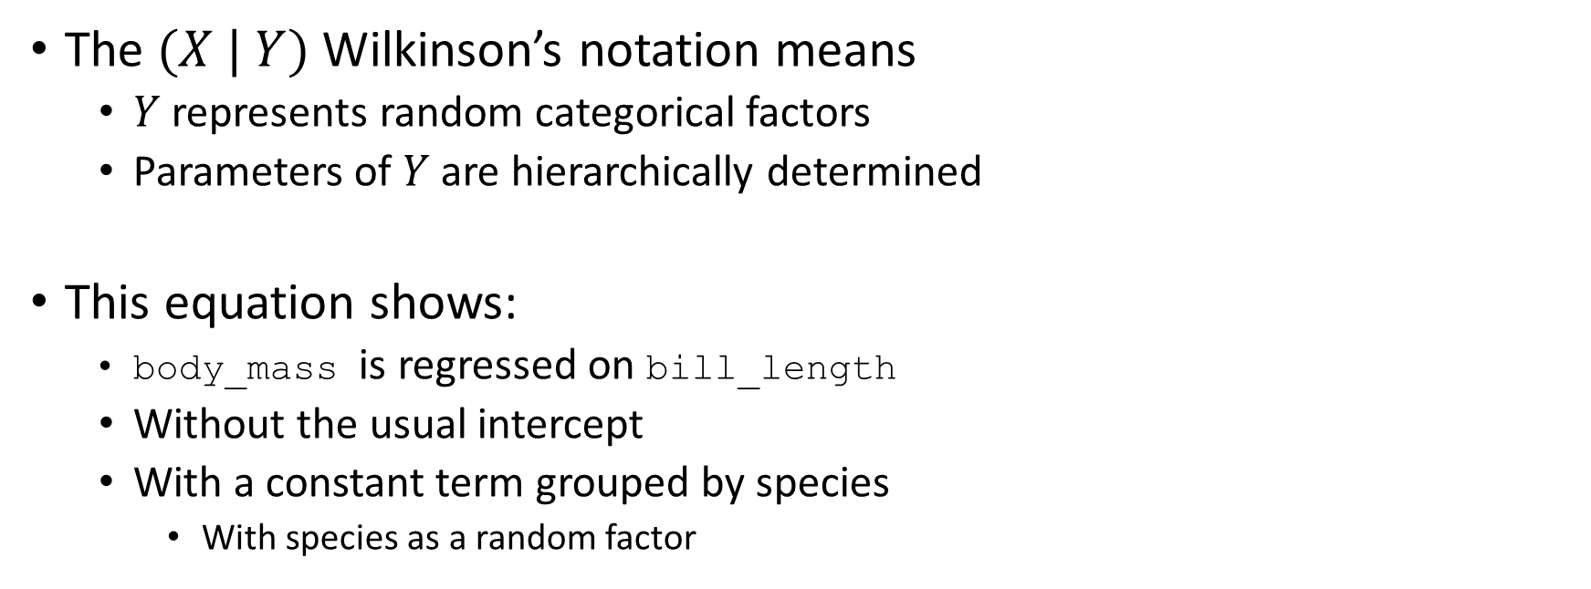
Hierarchical intercept in Bambi
model_hierarchy_bmb = bmb.Model("body_mass ~ 0 + bill_length + (1|species)", data=penguins)
The $(X | Y)$Wilkinson’s notation means
$Y$ represents random categorical factors
Parameters of $Y$ are hierarchically determined
This equation shows:
body_mass is regressed on bill_length
Without the usual intercept
With a constant term grouped by species
With species as a random factor

Slide 28
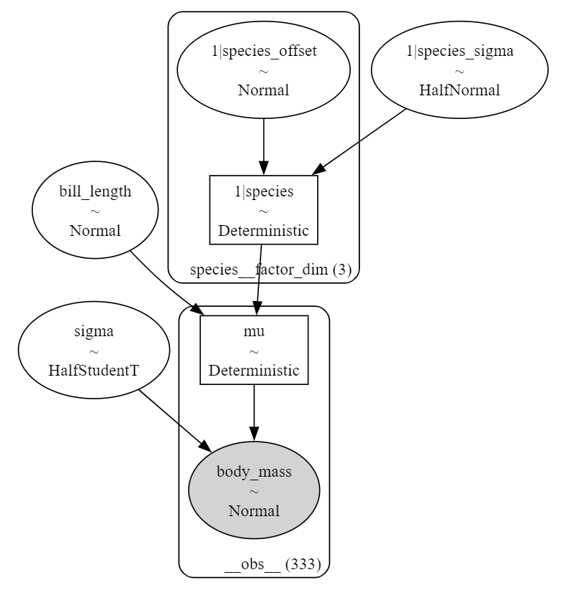
PyMC and Bambi hierarchical models very similar
model_hierarchy_bmb = bmb.Model("body_mass ~ 0 + bill_length + (1|species)", data=penguins)
PyMC
Bambi
Bambi model is non-centered
Bambi model uses half t instead of half normal

Slide 29
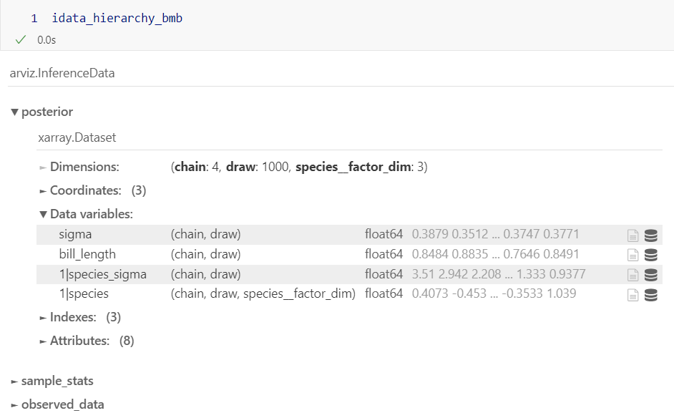
Note factor naming in the idata
model_hierarchy_bmb = bmb.Model("body_mass ~ 0 + bill_length + (1|species)", data=penguins)
Bambi

Slide 30

Very little change in results
bmb.interpret.plot_predictions(model_hierarchy_bmb, idata_hierarchy_bmb, ["bill_length", "species"])
Bambi

Slide 31
9D Modelling choices

Slide 32
Bambi formulas for hierarchical choices
Different intercepts, same slope
bmb.Model("body_mass ~ 0 + bill_length + (1|species)", data=penguins)
Different slopes, same intercept
bmb.Model("body_mass ~ (0 + bill_length|species)", data=penguins)
Different slopes, different intercept
bmb.Model("body_mass ~ (bill_length|species)", data=penguins)

Slide 33
Bambi formulas for modelling choices
Unpooled model
bmb.Model("body_mass ~ bill_length + species", data=penguins)
Hierarchical model
Different intercepts, same slope
bmb.Model("body_mass ~ 0 + bill_length + (1|species)", data=penguins)
Different slopes, same intercept
bmb.Model("body_mass ~ (0 + bill_length|species)", data=penguins)
Different slopes, different intercept
bmb.Model("body_mass ~ (bill_length|species)", data=penguins)

Slide 34
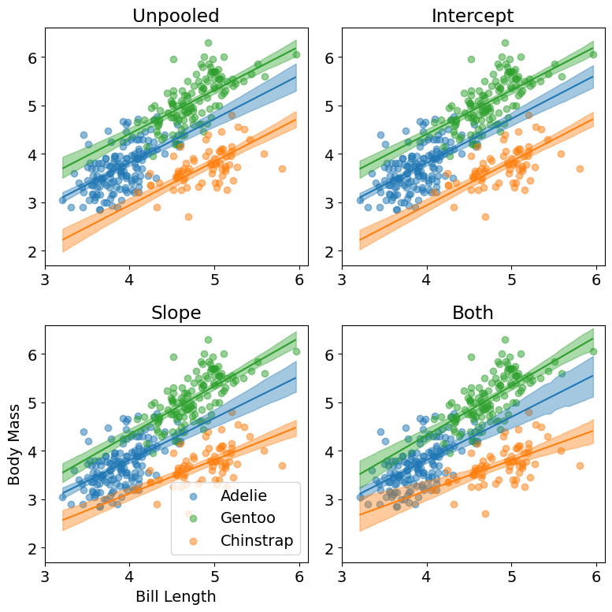
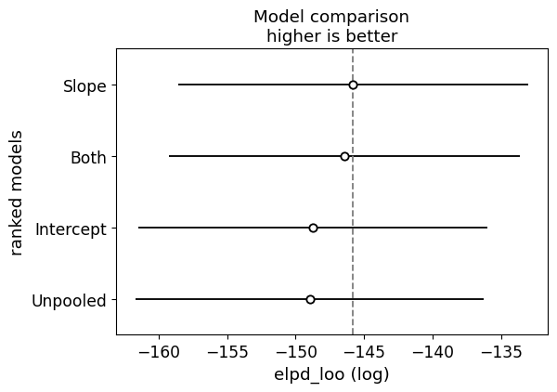
Results of modelling choices
az.plot_compare(az.compare(dict(zip(names, idatas))))

Slide 35
9E Reporting Bayesian Analyses

Slide 36
When do you need to report statistics?
Scientific reporting
Scientific paper
Grant application
Pre-registered research
Ethical approval
Medical reporting
Approval for drug or treatment
Ethical approval
Engineering
Patent application
Ethical approval

Slide 37
Different reporting standards
There are often strict rules about statistical reporting
Always check
When there are no rules, there are norms
Reporting for clinical trials is strict
Reporting for registering experiments is relaxed
Rules and norms change over time
Check recent publications or applications

Slide 38
General reporting guidelines
Three levels
Document
Appendix
Repository

Slide 39
General reporting guidelines
Three levels
Document
Methods
Results
Appendix
Repository
Methods:
Brief description of model
Brief statement on prior selection
Statement of diagnostics used
Methods for model comparison or hypothesis test
Results:
HDI for each important parameter
HDI, ROPE (if applicable), and effect size for important comparisons
Model comparison table if appropriate

Slide 40
General reporting guidelines
Model description:
Model description with equations and diagram
Full specification of priors with statement on prior selection
Sampling algorithms and parameters of those algorithms
Three levels
Document
Methods
Results
Appendix
Model description
Diagnostics
Results
Repository
Diagnostics:
Prior predictive plots and statistics
Diagnostic plots and statistics
Posterior predictive plots and statistics
Results:
Table of parameters with
Mean
HDI
ESS and MCSE
Prior or prior HDI (if applicable)

Slide 41
General reporting guidelines
Data:
Raw or preprocessed data should be in a public repository
Three levels
Document
Methods
Results
Appendix
Model description
Diagnostics
Results
Repository
Data
Code
Additional analyses
Code:
A Python notebook or script that runs all relevant analyses
From raw data
Through modeling and diagnostics
And through posterior plotting and interpretation
To statistical inference and model comparison
Notebook should reproduce all figures and computations in the paper
Additional analyses
Analyses that did not make the paper
Additional models
Alternative prior

Slide 42
9E Review

